Slide 1
The true wealth of nations
Howard Yin

Slide 2
CRITERIA USED
GDP
GINI COEFFICIENT
BIG MAC INDEX
ECONOMIC FREEDOM INDEX
HUMAN DEVELOPMENT INDEX
INCLUSIVE WEALTH INDEX
WHERE-TO-BE-BORN INDEX

Slide 3
Analyzing GDP
(Higher=better)
USA: 16.8 trillion
China: 9.24 trillion
Japan: 4.9 trillion
Sweden: 558.9 billion
Australia: 1.561 trillion
Vietnam: 171.4 billion
Qatar: 202.5 billion
Nigeria: 521.8 billion
Venezuela: 438.3 billion
GDP is one of the most traditional indicators of a country’s economic activity. It represents the total value of all goods and services produced by a certain nation each year. While lots of deficiencies surrounding GDP have begun to surface regarding the quality of life or environmental costs, GDP is nonetheless the universal benchmark of economic standing. Thus, we will be taking it into account in this presentation.

Slide 4
Analyzing GINI COEFFICIENT
(Lower=better)
USA: 40.8
China: 42.1
Japan: 32
Sweden: 25
Australia: 34
Vietnam: 35.6
Qatar: 41.1
Nigeria: 48.8
Venezuela: 44.8
The GINI coefficient measures the distribution of income within an economy. A common indicator of inequality, a Gini coefficient of 0 represents perfect quality, whereas a coefficient of 100 represents maximum inequality. Why are we representing a measure of inequality here? While the presentation is focused around which country having the most wealth, a country is made up of its citizens, and it would not make much sense for a certain country to be considered wealthy when most of its citizens squander in poverty.

Slide 5
Analyzing BIG MAC INDEX
USA: $4.80
China: $2.73 (undervalued by 43.1%)
Japan: $3.64 (undervalued by 24%)
Sweden: $5.95 (overvalued by 24.2%)
Australia: $4.81 (overvalued by 0.4%)
Vietnam: $2.83 (undervalued by 41.1%)
Qatar: $4.42
Nigeria: $7.11
Venezuela: $6.82 (overvalued by 42.2%)
Published by the Economist, the Big Mac Index is another method that underlies purchasing power parity. By comparing the prices of Big Macs in different countries, the index gives its readers a clear understanding of how over or undervalued the currency of that country is. Of 2014 (2015 has not yet been released), the value of the dollar has been getting stronger throughout the world (or at least in the fast food eating world).

Slide 6
Economic freedom index
(Higher=better)
USA: 75.5
China: 52.5
Japan: 71.8
Sweden: 73.1
Australia: 82.6
Vietnam: 51.0
Qatar: 71.2
Nigeria: 54.3
Venezuela: 36.3
The Index of Economic Freedom was created by the Heritage Foundation and the Wall Street Journal to measure the degree of economic freedom in the world. Parallel to Adam Smith’s approach, the belief here is that “the basic institutions that protect the liberty of individuals pursue their own economic interests result in greater prosperity for the larger society”.

Slide 7
Human development index
(Higher=better)
USA: 0.914
China: 0.719
Japan: 0.89
Sweden: 0.898
Australia: 0.933
Vietnam: 0.638
Qatar: 0.851
Nigeria: 0.504
Venezuela: 0.764
The Human Development Index is fairly similar to the Multidimensional Poverty Index, as they share the same 3 dimensions. Anyhow, it takes health, education, and living standards into account to rank countries by their stage of human development.

Slide 8
Inclusive wealth index
(Higher=better)
USA: 13
China: 47
Japan: 20
Sweden: 13
Australia: 7
Vietnam: 46
Qatar: -53
Nigeria: -30
Venezuela: -20
The Inclusive Wealth Index is a unique measure of wealth; it takes into account a country’s human and natural capital and IWI adjustments in order to predict how sustainable a country is, aiming at long-term growth.

Slide 9
Where-to-be-born index
(Higher=better)
USA: 7.38
China: 5.82
Japan: 7.08
Sweden: 8.02
Australia: 8.12
Vietnam: 5.64
Qatar: 6.49
Nigeria: 4.75
Venezuela: 5.93
Also another index by the Economist Intelligence Unit, the Where-to-be-born Index (WTBBI for the sake of shortening) measures each country’s ability to provide opportunities for a healthy, safe, and prosperous life. Frankly, it is better than the Happy Planet Index, simply because it takes into account more factors, including corruption, GDP per capita, political freedoms, life expectancy, job security, climate, gender equality, and physical security.

Slide 10
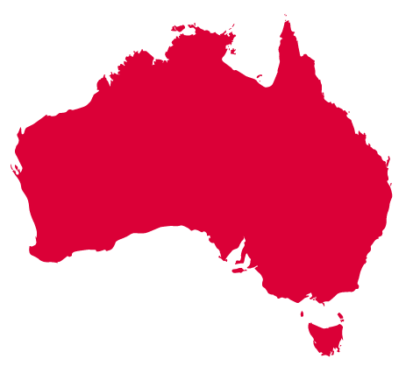
AUSTRALIA!
Highest median wealth in the world for five consecutive years
$402,578
Highest percentage of people with more than 100k
Wealth per household grew by 2.6% in a year
Shipping worth up to $252.2 billion of goods
Massive real-estate market

